Slide 1
Course 3 Capstone
Data Collection
Presented By : Omar ATTA

Slide 2
Finding the Middle
Mean, Median, and Mode help you compare data. Below, list the mean, median, and mode of the clicks in the provided data.
Mean: 60.38
Median: 60
Mode: 78

Slide 3
Finding the Middle
Mean, Median, and Mode help you compare data. Below, list the mean, median, and mode of the conversions in the provided data.
Mean: 5.98
Median: 6
Mode: 5

Slide 4
Standard Deviation
Determining variance in data helps you [understand how spread out the data is from the mean]. Below, enter the standard deviation of the provided data.
Standard Deviation of Clicks: 14.37
Standard Deviation of Conversions: 1.63

Slide 5

Frequency and Contingency Tables
Understanding how often something happens is important to understanding trends and patterns in your data. Create and insert a contingency table generated from your data.

Slide 6
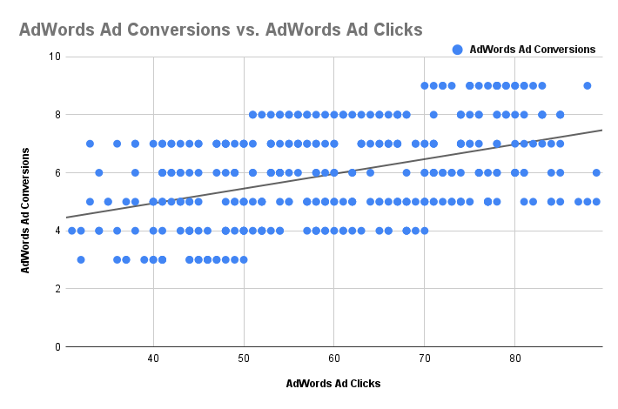
Scatter Plot
Understanding the relationships between data is important to understanding trends and patterns. Create and insert a scatter plot generated from your data. Then, include the input the correlation coefficient as well.
Scatter Plot of your data:
Correlation coefficient: 0.45
Conclusion : The correlation between the clicks and the conversions here is a “Low positive Correlation”

Slide 7
End of Section 1

Slide 8
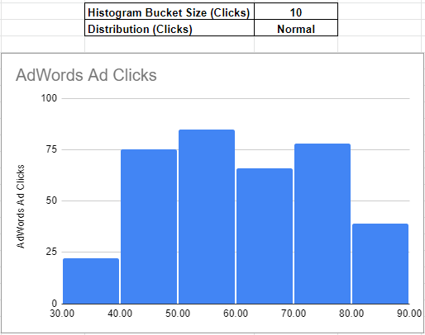
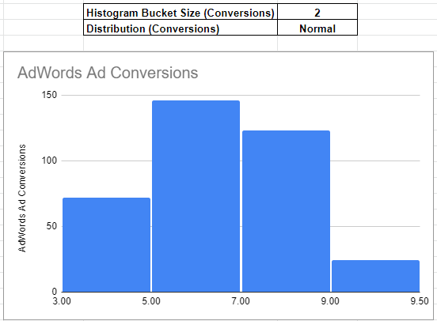
Sample Type
It’s important to understand the sample you’re using in your analysis. Fill in the information below about the sample you have received:
Histogram of your clicks data:
Histogram of conversions data:

Slide 9
Sample Type
It’s important to understand the sample you’re using in your analysis. Fill in the information below about the sample you have received:
Does the clicks data have a normal distribution? (YES)
Does the conversions data have a normal distribution? (YES)

Slide 10
Variable Types
Determining the types of variables your working with is an important skill. Below, list the variables from your data that are:
Quantitative:
Continuous: (AdWords Click-Through Rate (Clicks / View), AdWords Conversion Rate (Conversions / Click), AdWords Cost per Click (Ad Cost / Clicks))
Discrete: ( AdWords Ad Views, AdWords Ad Clicks, AdWords Ad Conversions, Cost per AdWords Ad)
Qualitative:
Nominal: xx
Ordinal: xx

Slide 11
End of Section 2

Slide 12
Question and Hypothesis
The question you hope to answer and your hypothesized answer are necessary to complete an analysis. Answer the following questions
What is your hypothesis based off the evaluation question?
Our number of conversions will be greater if we advertise on Facebook platform rather than AdWords platform.

Slide 13
Question and Hypothesis
The question you hope to answer and your hypothesized answer are necessary to complete an analysis. Answer the following questions
What is your independent variable?
Independent variable is : The Platform (Facebook)
What is your dependent variable?
dependent variable is : The Conversions Number

Slide 14
Running a Test
With your question and hypothesis ready, run the test on the two sets of data. Fill in the information below.
Mean number of Facebook conversions: 11.74
Mean number of AdWords conversions: 5.98
P-Value: 0.00

Slide 15
Hypothesis
After running the test, was your hypothesis proven correct? (YES)
Do your findings support a null or an alternative hypothesis? (Alternative Hypothesis)
What’s your conclusion about your main hypothesis? Is there a difference, and is it what your hypothesis predicted?
Yes, i can see there is a huge difference in numbers of conversions between Facebook and AdWords.
As i can see that my predicted hypothesis was correct as the number of conversions in Facebook platform is way higher than the one in the AdWords platform.

Slide 16
End of Section 3

Slide 17
Determining a Model
Based off what you know so far, you’ll need to determine if your data meets the assumptions for a chosen model. Including:
Which model makes the most sense to use and why?
The model name: “Simple Linear Regression”
Reasons To Use It:
Purpose: Predicting The Probability of Increasing The FB Ad Conversions Based on Increasing FB Ad Clicks.
Variables Requirements: The Independent Variable (FB Ad Clicks) & The Dependent Variable (FB Ad Conversions)
Assumptions Met: (minimum sample size:50, Linearity, Normality, Homogeneity of Variance, Independence)

Slide 18
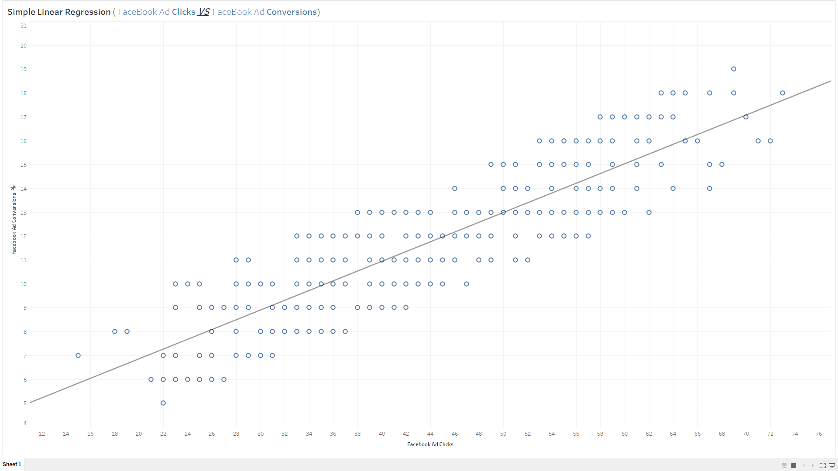
Modeling
Finally, include a visualization of your complete model.

Slide 19
End of Section 4

Slide 20
Final Insights
Now, knowing what you do about the results of your test, what are the final insights that you would share with your client? What did you learn and what would you recommend? Is there anything you would do differently next time?
- My Final Insights Eventually Would Be:
1- The correlation between the clicks and the conversions on the AdWords Platform is a “Low positive Correlation”.
2- The correlation between the clicks and the conversions on the Facebook Platform is a “High positive Correlation”.
3- I Found That The Number of Conversions Are Greater On Facebook Platform Than The AdWords Platform.
-My Recommendations For The Future:
1- Focusing More on the facebook platform and spend more on the next campaigns that will be launched On it as more seeing leads to more clicks and eventually more conversions (more purchases)
2- Enhancing the quality of the campaigns on the AdWords platform to target more specific customers and have less variance to have more reliable data to help in building stronger campaigns in the future.

